Slide 1

Versatile yet Lightweight Record-and-Replay for Android
Yongjian Hu Tanzirul Azim Iulian Neamtiu

Slide 2
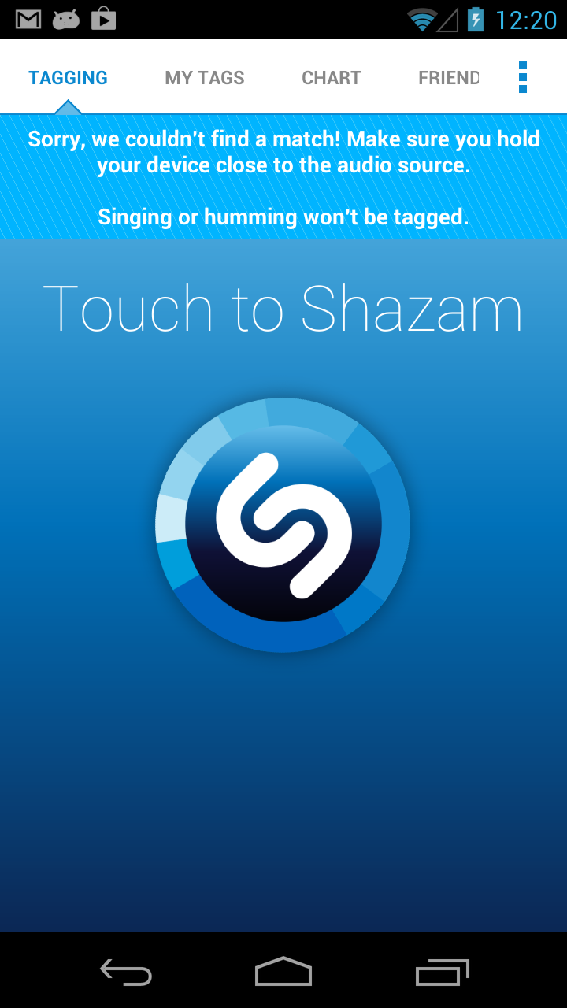
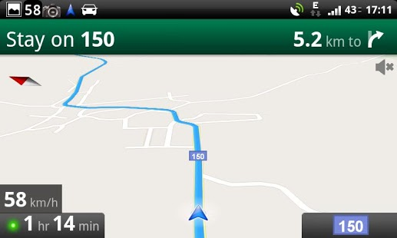
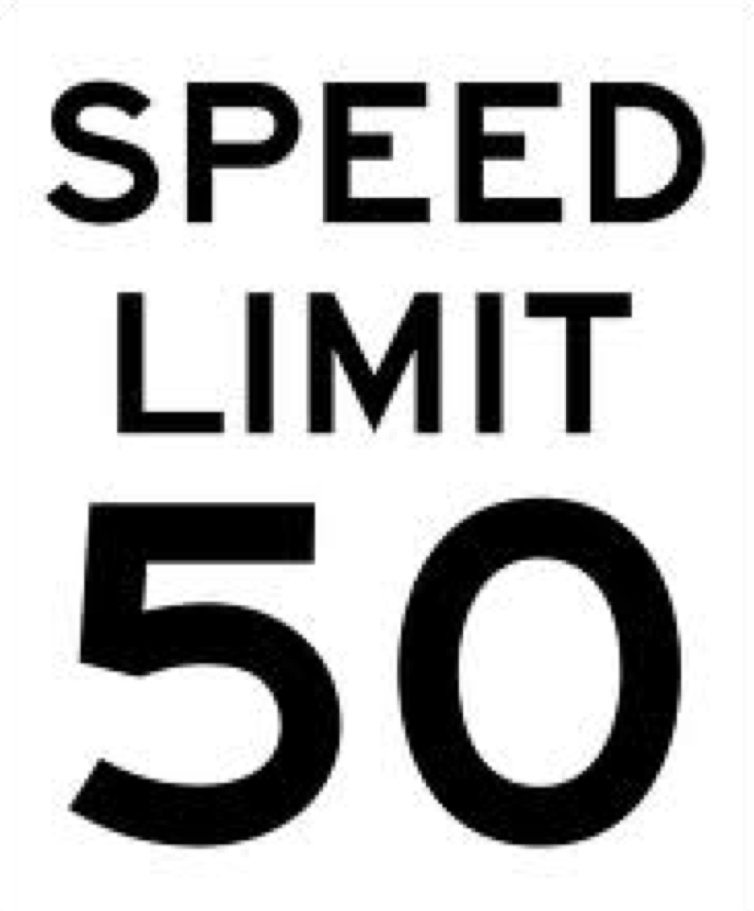
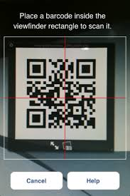
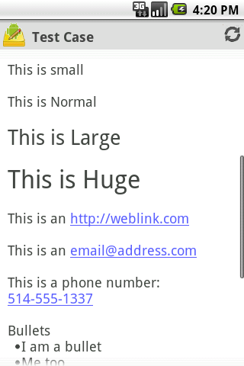
Replay GPS trace
Debug Shazam
Record-and-replay is
useful in a variety of
Android development
scenarios
Debug Barcode Scanner
Reproduce event-driven race in Tomdroid
Crash!
Notes:
Update the color and size.

Slide 3
Replay GPS trace
Debug Shazam
Record-and-replay is
useful in a variety of
Android development
scenarios.
Challenges:
Sensor driven
High-throughput parallel sensor streams
Debug Barcode Scanner
Reproduce event-driven race in Tomdroid
Crash!

Slide 4
Replay GPS trace
Debug Shazam
Record-and-replay is
useful in a variety of
Android development
scenarios
Challenges:
Sensor-driven: high-throughput parallel sensor streams
Timing is essential: incorrect timing may cause replay to diverge
Debug Barcode Scanner
Reproduce event-driven race in Tomdroid
Crash!

Slide 5
Replay GPS trace
Debug Shazam
Record-and-replay is
useful in a variety of
Android development
scenarios.
Challenges:
Sensor-driven
High-throughput parallel sensor streams
Timing is essential
Incorrect timing may cause replay to diverge
Event-oriented
Event schedule matters
Debug Barcode Scanner
Reproduce event-driven race in Tomdroid
Crash!

Slide 6
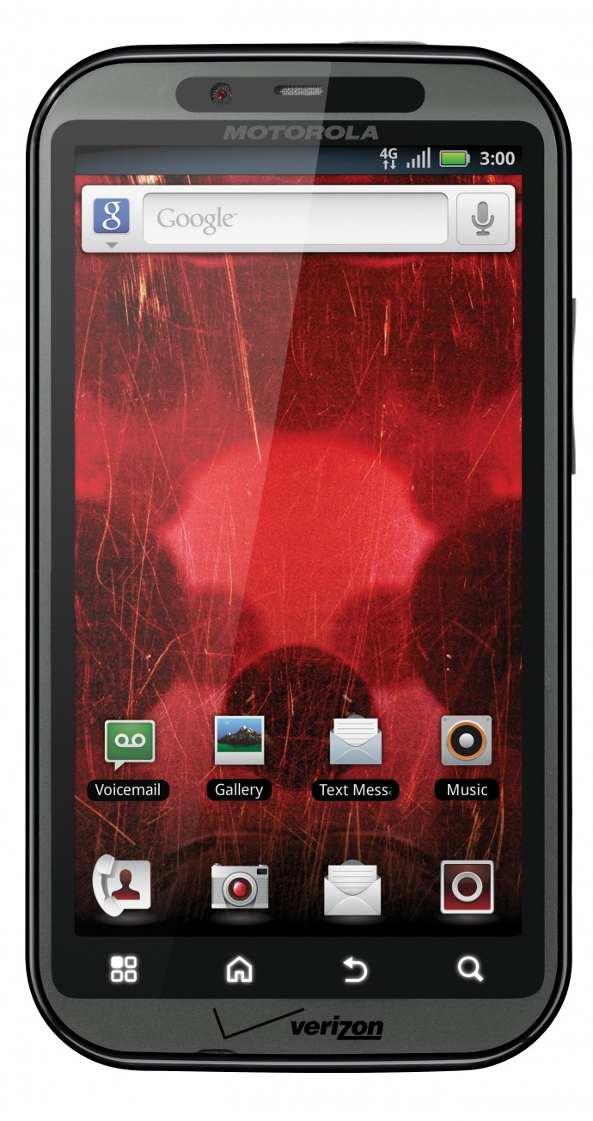
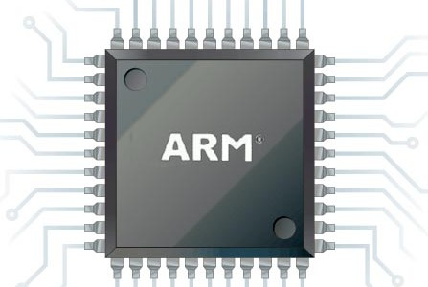
Goal: record and replay Android app executions
Record and replay level
Apps
App₁
App₂
App₃
GUI actions, e.g., RERAN (ICSE’13) Low fidelity, low overhead
Application Framework
VM/ART, Libraries, Android Runtime
Dalvik (VM) instructions Moderate fidelity, high overhead
Linux Kernel
CPU instructions, e.g., PinPlay High fidelity, very high overhead

Slide 7
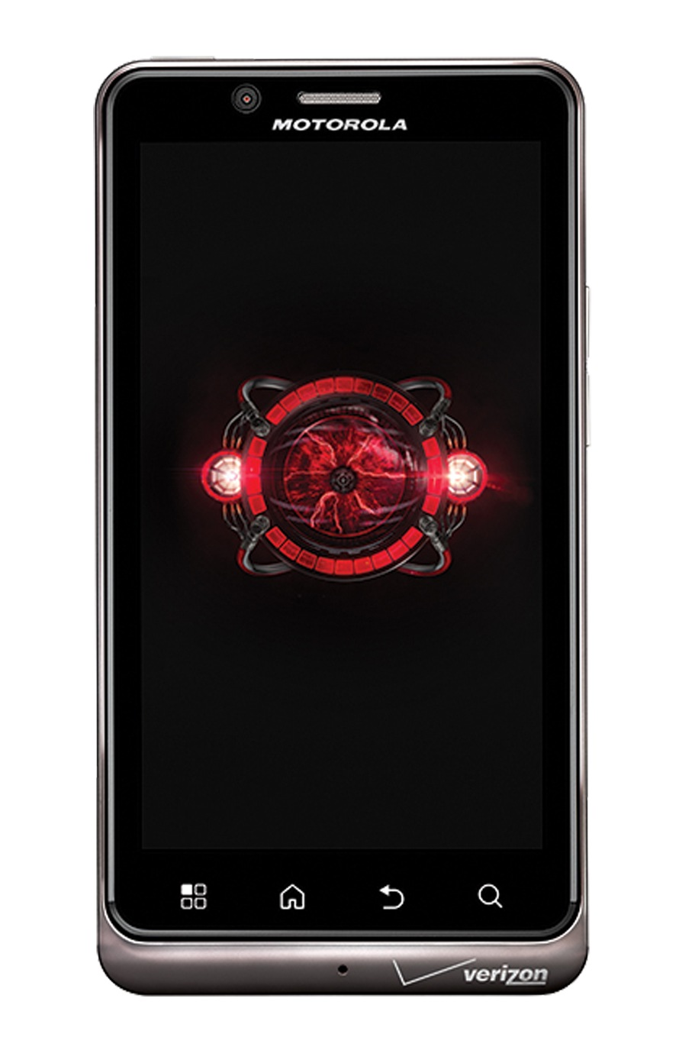

VALERA
GPS
Camera
Microphone
Schedule
Runs on real phones App source code not required Handles complex sensor input
Low overhead
Replay fidelity guarantees (observable state)
Touchscreen
Compass
Accelerometer
Light sensor
VALERA: VersAtile yet Lightweight rEcord and Replay for Android

Slide 8
VALERA Architecture
VALERA binary rewriting
App
Instrumented App
VALERA runtime
GPS
Mic.
Camera
Intents
Event schedule
Network
Android Framework
modified
ScheduleReplayer
Touchscreen
Accelerometer
…
Dalvik VM
Linux kernel

Slide 9
VALERA Intercepts the (Sensor) API via Bytecode Rewriting
[Location]
[downcall]
public Location getLastKnownLocation(…)
[upcall]
public void onLocationChanged(…)
……
[Camera]
[upcall]
public void onPictureTaken(byte[] data, …)
public void onPreviewFrame(byte[] data, …)
……
[AudioRecorder]
[downcall]
public int read(byte[] audioData, ……)
public int read(ByteBuffer audioBuffer, ……)
……
Interceptor specification
GPS
Mic
Intents
Camera
. . .
APK
Scanner
Interceptor generator
Original app
APK
Redexer
Instrumented app

Slide 10
Event Schedule is Essential
UI Thread
Decoder Thread
onResume()
Fork thread
init()
Frame 1
Start decoding
Frame 2
decode()
Decode failed
Show decode failed
Frame 3
Start decoding
decode()
Decode success
Show decode success

Slide 11
Event Schedule is Essential
UI Thread
Decoder Thread
onResume()
Fork thread
init()
Frame 1
Start decoding
Frame 2
decode()
Frame 3
Decode failed
Show decode failed

Slide 12
Prior Work on Deterministic Replay
Hardware-based approaches
Special HW required: [FDR’03, BugNet’05, ReRun’09, DeLorean’09, DMP’09]
Software-based approaches
VM-level: [SMP-ReVirt’08, King et al. ATC’05]
User-level:
Sync-Sched: [Recplay’99, JaRec’04, Kendo’09]
Mem-Sched: [CoreDet’10, LEAP’10, STRIDE’12, CLAP’13]
Probabilistic: [ODR’09, PRES’09]
Limitations
HW approach too expensive
VM/Mem-Sched approaches’ overhead too high
Not suitable for Android’s event-driven scheduling

Slide 13
Android Event Handling
Thread
Handler
UI Thread
Message Queue
Thread
Looper
msg
evt
msg
Handler
Hardware Events

Slide 14
Deterministic Event Schedule: Recording
UI Thread
Message Queue
Event Log
Looper
A
B
C
D
1
2
3
4

Slide 15
Deterministic Event Schedule: Replaying
Reconciling different event orders between record and replay
Controller =
4
3
1
2
UI Thread
Message Queue
Event Log
Looper
B
D
C
A
A
B
C
D
1
2
3
4
Pending Queue

Slide 16
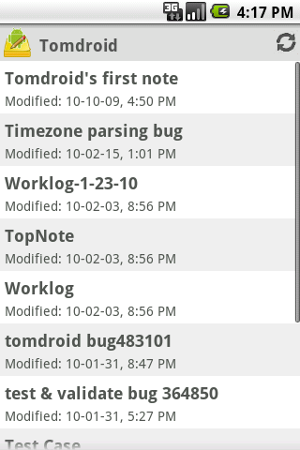


Example: Reproducing Tomdroid’s Event Bug
Syncing…
Done!
Back

Slide 17
Example: Reproducing Tomdroid’s Event Bug
Syncing…
Crash!
Back

Slide 18
Application: Reproducing Event-driven Races
Get potential race bugs from state-of-art race detectors for Android
DroidRacer [PLDI’14], CAFA [PLDI’14]
EventRacer [OOPSLA’15]
Use Valera to reproduce event-driven race bugs by alternative schedule
See the paper for examples:
NPR News, Tomdroid, Anymemo

Slide 19
Evaluation: Event Throughput
Main Interceptor | Apps | GPS | Camera/Buffer | Audio | Intent | Network | Sched
GPS |  | 70 |  |  |  | 128 | 1,603
Camera |  |  | 53 |  |  | 35 | 1,352
Audio |  |  |  | 386 |  | 41 | 1,545
Intent |  |  |  |  | 9 | 48 | 1,849
Replaying sensors, schedules is crucial!
Notes:
Bump up the fonts.

Slide 20
Evaluation: Performance
Main Interceptor | Apps | Record Time (sec) | Replay Time (sec) | Overhead (%) | Log Size (KB) | Log Rate (KB/s)
GPS |  | 247 | 249 | 0.766 | 28 | 0.095
Camera |  | 111 | 113 | 1.137 | 91,758 | 881
Audio |  | 126 | 128 | 1.35 | 11,171 | 239
Intent |  | 65 | 66 | 1.459 | <1 | <0.03
Notes:
Add red retangle like PLDI’09 slide p24.

Slide 21
Conclusions
Record-and-Replay on Android is challenging
Rich sensors
Timing is essential
Event schedule non-determinism
Our approach: sensor-oriented replay (VALERA)
High fidelity, low overhead
Scalable and extensible via API interceptors
Deterministic event schedule replay
Reproduce and verify event-driven races

Slide 22
Q & A

Slide 23
Experiments: Number of Events
Main Interceptor | Apps | #GPS | #Camera/Buffer | #Audio | #Intent | #Network | #Sched
GPS | GasBuddy∗, Sygic: GPS N.&M., TripAdvisor, Waze Social GPS, Yelp∗, Flixster∗, Scout GPS Navig., Route 66 Maps, GPSNavig.&Maps, NavFreeUSA | 70.5 |  |  |  | 128 | 1603
Camera | Barcode Scanner, Google Goggles, Pudding Camera, Evernote∗, Amazon Mobile∗, QR Droid, CamScanner, CamCard Free, RedLaser Barcode, Walmart |  | 53.83 |  |  | 35 | 1352
Audio | Shazam, SoundHound, GO SMS Pro, Tune Wiki∗, SoundCloud, musiXmatch, Best Voice Changer, Smart Voice Recorder, PCM Recorder, RoboVox Lite |  |  | 386 |  | 41 | 1545
Intent | Twitter∗, Google Translate∗, Instagram∗, eBay∗, Bible∗, Craigslist∗, Dictionary∗, GO SMS Pro Emoji, Weibo, Weather |  |  |  | 9.5 | 48 | 1849

Slide 24
Experiments: Performance
Main Interceptor | Apps | Record Time (sec) | Replay Time (sec) | Overhead (%) | Log Size (KB) | Log Rate (KB/s)
GPS | GasBuddy∗, Sygic: GPS N.&M., TripAdvisor, Waze Social GPS, Yelp∗, Flixster∗, Scout GPS Navig., Route 66 Maps, GPSNavig.&Maps, NavFreeUSA | 247 | 249 | 0.766 | 28 | 0.095
Camera | Barcode Scanner, Google Goggles, Pudding Camera, Evernote∗, Amazon Mobile∗, QR Droid, CamScanner, CamCard Free, RedLaser Barcode, Walmart | 111 | 113 | 1.137 | 91,758 | 881
Audio | Shazam, SoundHound, GO SMS Pro, Tune Wiki∗, SoundCloud, musiXmatch, Best Voice Changer, Smart Voice Recorder, PCM Recorder, RoboVox Lite | 126 | 128 | 1.35 | 11,171 | 239
Intent | Twitter∗, Google Translate∗, Instagram∗, eBay∗, Bible∗, Craigslist∗, Dictionary∗, GO SMS Pro Emoji, Weibo, Weather | 65 | 66 | 1.459 | <1 | < 0.03

Slide 25
Conclusions
Challenges of record and replay on Android:
Rich sensors; Timing is essential; Correct event order matters;
Our approach: VALERA API interception; Deterministic event order replay;
Results: 50 widely-popular apps from Google Play Trace is portable across devices 1% runtime overhead for either record or replay
Replay fidelity: same observable app and system state between record and replay runs
Notes:
Successful replay: screen looks the same as during record Limitations: network non-determinism, dynamic layout
Adobe Reader
Amazon Mobile
Angry Birds Rio
Angry Birds Seasons
Angry Birds Space
Background HD Wallpapers
Baseball Superstars 2012
BBC News
Bible
BMX Boy
Boxing game
Brightest Flashlight
Bubble Shoot
Color Note
Craigslist Mobile
Crime City
Daily Horoscope
Dance Legend
Death Rally Free
Dictionary
Drag Racing
Drag Racing- Bike Racing
Draw Something
Easy Battery Saver
eBay
Espn Score Center
Evernote
Facebook
Feed Your Dino Free
Fruit Ninja
Gas Buddy
Google Earth
Google Play Books
Google Play Movies
Google Plus
Google Search
Google Translate
Groupon
HeartRadio
How to Read Thoughts
iFunny
IMDB
Instagram
Jewels Star
Kindle
Maps
Movies by Flixster
MP3 Ringtone Maker
Myxer
NBA Gametime
One Touch Drawing
Pandora
Picsart
Pool Master Pro
PulseNews
Recipe Search
Running Fred
Shoot Bubble Deluxe
Sincerely Ink Cards
Sky Map
Slacker Radio
Slot City Machines
Solitaire
Stick Man BMX Stunts Bike
Talking Tom 2
TED
Temple Run
Tetris
Textgram
TouchNote PostCards
Tunewiki
Twitter
Unblock me Free
Unicorn Dash
Uno Free
Visual Anatomy
Weather Bug
Weather Channel
Where's my water
Word Search
Words with Friends
Yellow Pages
Yelp
Youtube
Zedge
Zinio
Sygic: GPS Nav&Maps
TripAdvisor
Waze Social GPS
Flixster
Scout GPS Nav.
Route 66 Maps
GPSNavig.&Maps
NavFreeUSA
Barcode Scanner
Google Goggles
Pudding Camera
QR Droid
CamScanner
CamCard Free
RedLaser Barcode
Walmart
Shazam
SoundCloud
musiXmatch
Best Voice Changer
Smart Voice Recorder
PCM Recorder
RoboVox Lite
Voice Search Lnch.
----- Meeting Notes (11/28/12 11:27) -----
say will discuss why we couldnt replay the 14

